Slide 1
Economics 144 Economic Forecasting
Lecture 6
White Noise
Dr. Randall R. Rojas

Slide 2
Today’s Class
White Noise
White Noise Example
R Demo

Slide 3



White Noise 1 of 3
Time Series Process: Let y denote the observed series of interest.
White Noise: Time series process with zero mean, constant variance, and no serial correlation.
Where ε_{t} (“shock”) is uncorrelated over time.
Therefore, y_{t} and ε_{t} are serially uncorrelated.
and

Slide 4
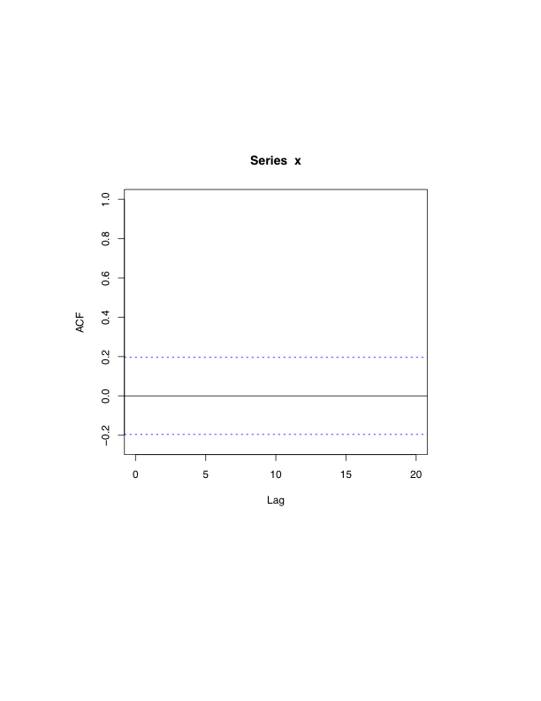
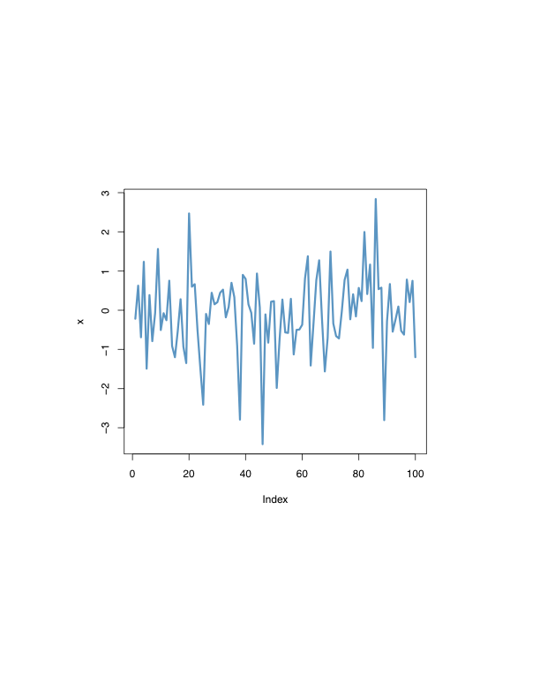

White Noise 2 of 3
Gaussian White Noise: If y is serially uncorrelated and normally distributed, and thus, serially independent .
Process
ACF
Time
Displacement
Notes:
The model fits our data if after filtering the trend and seasonality to get the residuals, the acf of residuals is very low.

Slide 5
White Noise 3 of 3
Given: →E(y_{t}) = 0 and var(y_{t}) = σ²
However, recall that σ² = γ(0)→
σ², k =0
0, k ≥ 1
1, k =0
0, k ≥ 1
γ(k) =
and
ρ(k) =
Autocovariance Function
Autocorrelation Function
1, k =0
0, k ≥ 1
Note 1: Please solve problems 3
and 4 from Chapter 7^{b}.
Note 2: Please review conditional
means and conditional variances
(see e.g., page 122^{b}).
p(k) =
Partial Autocovariance Function
Notes:
-Suppose your ets shows that the trend seems stochastic rather than deterministic, the plot may not have a trend and only showing the residuals
-to look at how much the noise affects the plot, you could make the numbers of the white noise larger than the amplitude

Slide 6
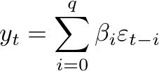
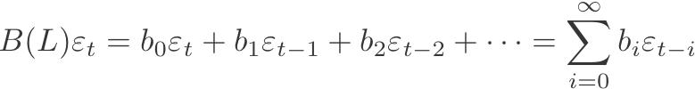
The Lag Operator (Review)
Recall: Distributed lag of current and past shocks:
Example: Use a white-noise process to construct a more complex time series:
,
Notes:
IF you take the past lagged shocks, the sum is no longer a white noise since there is correlation between different lags, so it could yield significant result

Slide 7
White Noise Example (Moving Average)
Example: Suppose you win $1 if a fair coin shows heads and loose $1 if it shows tails.
Denote the outcome on toss t by ε_{t} (i.e., for toss t, ε_{t} is either +$1 or -$1).
If you want to keep track of your ‘hot streaks’, you can e.g., calculate your average winnings on the last four tosses. For each coin toss t, your average payoff on the last four tosses is:
Notes:
This example would emphasis the short term dynamics

Slide 8
White Noise Example (Moving Average)
Case 1: We can set e.g., β_{i} = ¼ for i≤3.
Case 2: We can set e.g., β₀ = β₁ = 1, and all other β_{i} =0.
For this case, although the {ε_{t}} sequence is a white-noise process, the constructed {x_{t}} sequence will not be a white-noise process is two or more of the β_{i} differ from 0.
E[x_{t}] = E[ε_{t} + 0.5ε_{t-1}] = 0 and
var[x_{t}] = var[ε_{t} + 0.5ε_{t-1}] = 1.25σ²
cov(x_{t}, x_{t-1}) = 0.5σ² ≠ 0
White-noise conditions
are satisfied.
→{x_{t}} is not a white noise process!
Note: Case 2 is known as an ‘MA(1)’ Process
Notes:
This superposition still conserves the expectation and the variance constant. But the covariance is not 0, which implies that the its not 2nd order stationarity
You should use some structure for acf, since the cov is not 0. But the pacf should be flat at 0 since there shouldn’t be any dependence between one period to another

Slide 9



Estimation and Inference 2 of 3
Q: How can we assess whether a series is reasonably approximated as white noise?
A: If the series is white noise, then for large samples:
The sample autocorrelations are unbiased
estimators of the true autocorrelations.
Square both sides

Slide 10
For Next Class
Readings about today’s class:
Chapter 7^{b}
Review Exercises / Problems:
Chapter 7^{b}: 3, 4, 5, 8, 10, 11
Readings for next class:
Chapter 6ª

